Slide 1


Slide 2

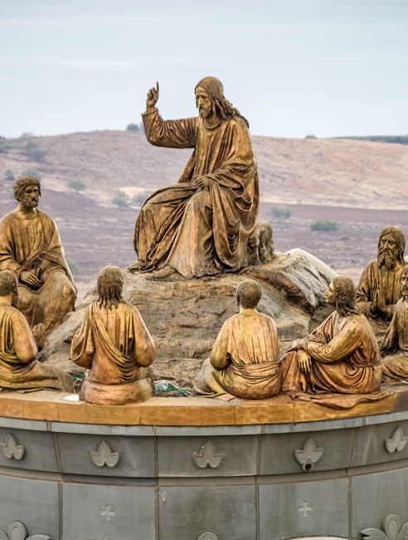
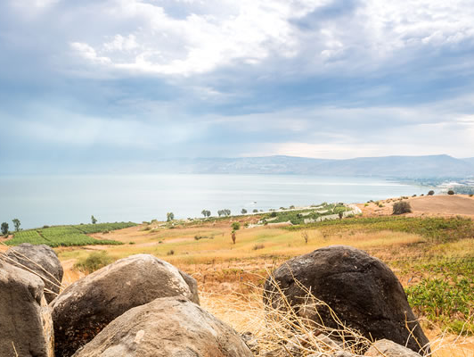

Slide 3
3“Blessed are the poor in spirit, for theirs is the kingdom of heaven.
4“Blessed are those who mourn, for they shall be comforted.
5“Blessed are the meek, for they shall inherit the earth.

Slide 4
6 “Blessed are those who hunger and thirst for righteousness, for they shall be satisfied.
7“Blessed are the merciful, for they shall receive mercy.
8“Blessed are the pure in heart, for they shall see God.
9“Blessed are the peacemakers, for they shall be called sons of God.

Slide 5
10“Blessed are those who are persecuted for righteousness’ sake, for theirs is the kingdom of heaven.
11“Blessed are you when others revile you and persecute you and utter all kinds of evil against you falsely on my account.
12Rejoice and be glad, for your reward is great in heaven, for so they persecuted the prophets who were before you.

Slide 6
¹³“You are the salt of the earth, but if salt has lost its taste, how shall its saltiness be restored? It is no longer good for anything except to be thrown out and trampled under people’s feet. ¹⁴“You are the light of the world. A city set on a hill cannot be hidden.

Slide 7
¹⁵Nor do people light a lamp and put it under a basket, but on a stand, and it gives light to all in the house. ¹⁶In the same way, let your light shine before others, so that they may see your good works and give glory to your Father who is in heaven.
Matthew 5:13-16

Slide 8
Be influential salt by being a preserving agent in a corrupt society
¹³“You are the salt of the earth, but if salt has lost its taste, how shall its saltiness be restored? It is no longer good for anything except to be thrown out and trampled under people’s feet.

Slide 9
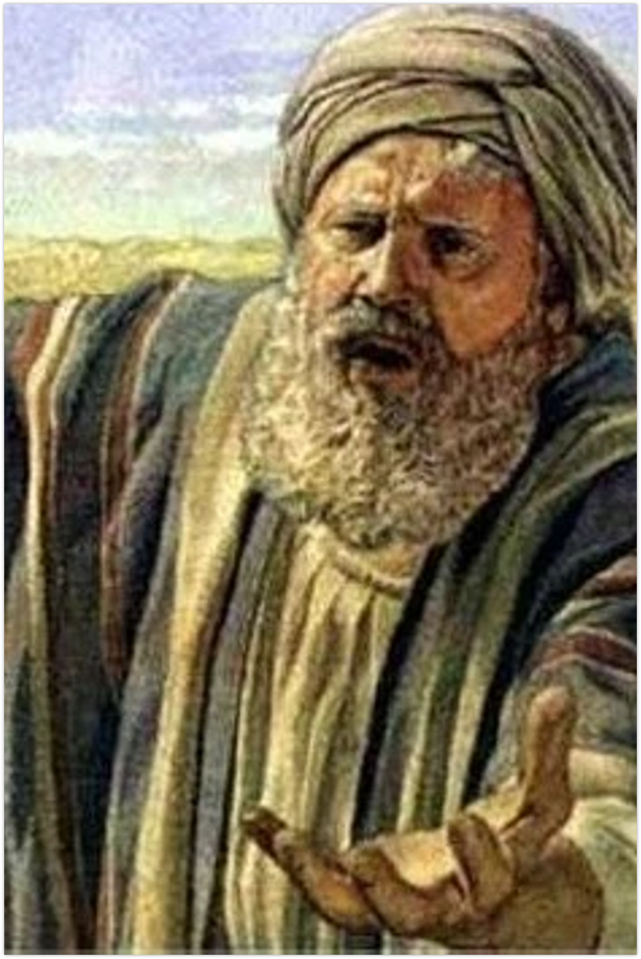

“Will you indeed sweep away the righteous with the wicked? Suppose there are fifty righteous within the city. Will you then sweep away the place and not spare it for the fifty righteous who are in it? Far be it from you to do such a thing, to put the righteous to death with the wicked, so that the righteous fare as the wicked! Far be that from you! Shall not the Judge of all the earth do what is just?”
Genesis 18:23-25

Slide 10
And the Lord said, “If I find at Sodom fifty righteous in the city, I will spare the whole place for their sake.”
Genesis 18:26

Slide 11
Be influential salt by partnering with the team.
¹³“You are the salt of the earth, but if salt has lost its taste, how shall its saltiness be restored? It is no longer good for anything except to be thrown out and trampled under people’s feet.

Slide 12
Be influential salt by putting off the impurities that makes our salt tasteless.
¹³“You are the salt of the earth, but if salt has lost its taste, how shall its saltiness be restored? It is no longer good for anything except to be thrown out and trampled under people’s feet.

Slide 13
Be influential salt by putting off the impurities that makes our salt tasteless.
Repent
Renew
Regain

Slide 14
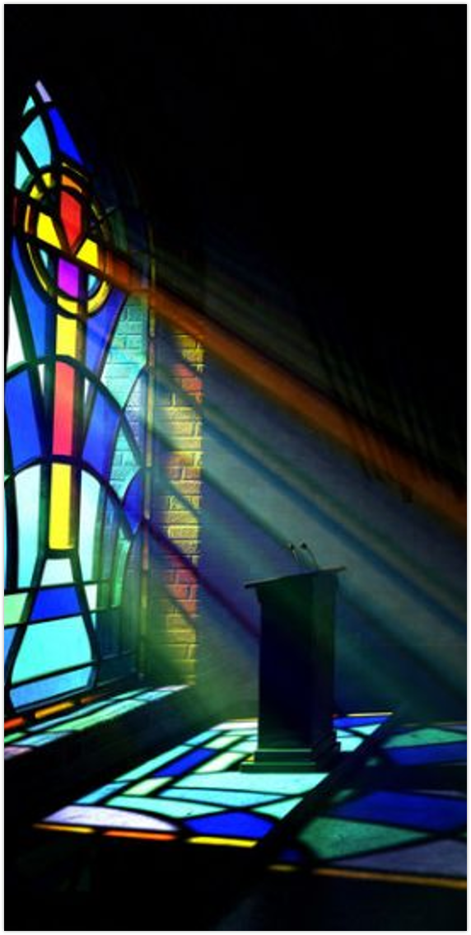
¹⁴“You are the light of the world. A city set on a hill cannot be hidden. ¹⁵Nor do people light a lamp and put it under a basket, but on a stand, and it gives light to all in the house.

Slide 15
Be influential light by going public with it.
¹⁴“You are the light of the world. A city set on a hill cannot be hidden. ¹⁵Nor do people light a lamp and put it under a basket, but on a stand, and it gives light to all in the house.

Slide 16
Be influential light by doing works that glorify God.
¹⁶In the same way, let your light shine before others, so that they may see your good works and give glory to your Father who is in heaven.

Slide 17
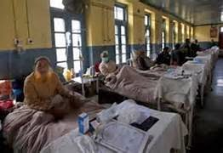
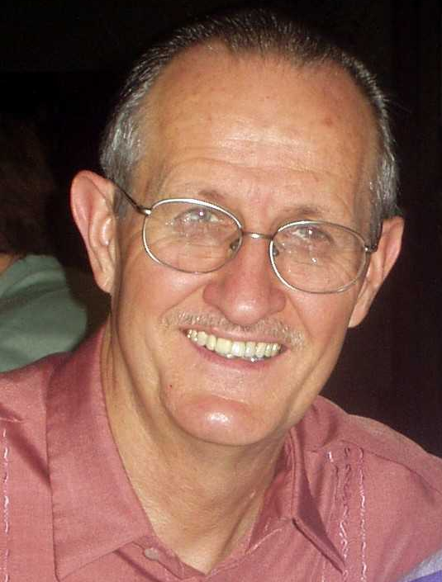
Be influential light by doing works that glorify God.
¹⁶In the same way, let your light shine before others, so that they may see your good works and give glory to your Father who is in heaven.

