Slide 1


Slide 2

EXODUS 34:6-7
(6) The Lord passed before him and proclaimed, “The Lord, the Lord, a God merciful and gracious, slow to anger, and abounding in steadfast love and faithfulness,

Slide 3
EXODUS 34:6-7
(7) keeping loyal love for thousands, forgiving iniquity and transgression and sin, but who will by no means clear the guilty...

Slide 5
FAITHFULNESS

Slide 6
Then Jesus went with them to a place called Gethsemane, and he said to his disciples, “Sit here, while I go over there and pray.” 37 And taking with him Peter and the two sons of Zebedee, he began to be sorrowful and troubled. 38 Then he said to them, “My soul is very sorrowful, even to death; remain here, and watch with me.”
Matthew 26:36-46

Slide 7
39 And going a little farther he fell on his face and prayed, saying, “My Father, if it be possible, let this cup pass from me; nevertheless, not as I will, but as you will.” 40 And he came to the disciples and found them sleeping. And he said to Peter, “So, could you not watch with me one hour?
Matthew 26:36-46

Slide 8
41 Watch and pray that you may not enter into temptation. The spirit indeed is willing, but the flesh is weak.” 42 Again, for the second time, he went away and prayed, “My Father, if this cannot pass unless I drink it, your will be done.” 43 And again he came and found them sleeping, for their eyes were heavy.
Matthew 26:36-46

Slide 9
44 So, leaving them again, he went away and prayed for the third time, saying the same words again. 45 Then he came to the disciples and said to them, “Sleep and take your rest later on. See, the hour is at hand, and the Son of Man is betrayed into the hands of sinners. 46 Rise, let us be going; see, my betrayer is at hand.”
Matthew 26:36-46

Slide 10
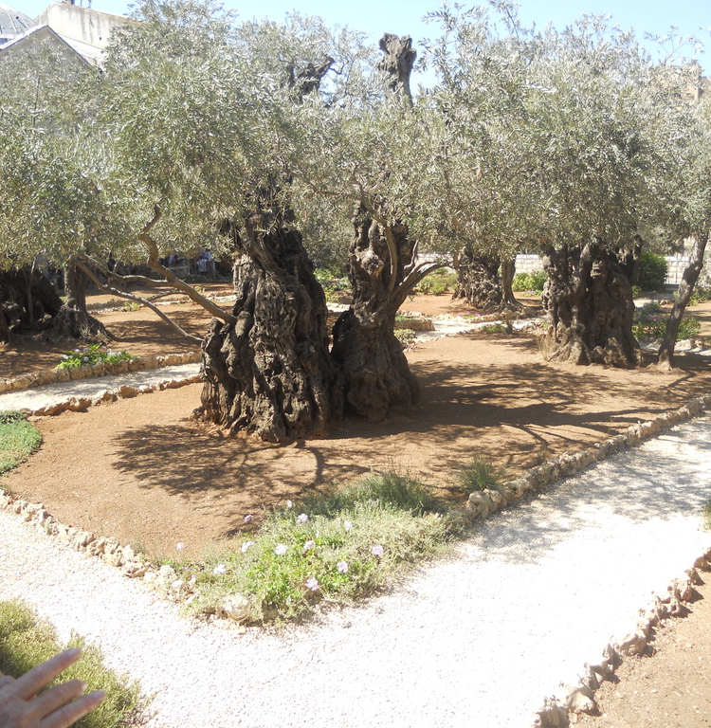
  GARDEN OF
  GETHSEMANE

Slide 11
FAITHFUL TO THOSE GOD GAVE HIM

Slide 12
FAITHFUL TO THE WILL OF GOD

Slide 13

“In the days of His flesh, Jesus offered up prayers and supplications, with loud cries and tears, to Him who was able to save Him from death, and He was heard because of His reverence. 8 Although He was a Son, He learned obedience through what He suffered. 9 And being made perfect, He became the source of eternal salvation to all who obey Him”
Hebrews 5:7-9

Slide 14
FAITHFUL TO THE WAY OF GOD

Slide 15
“Have this attitude in yourselves which was also in Christ Jesus, 6 who, although He existed in the form of God, did not regard equality with God a thing to be grasped,7 but emptied Himself, taking the form of a bond-servant, and being made in the likeness of men. 8 Being found in appearance as a man, He humbled Himself by becoming obedient to the point of death, even death on a cross.”
Philippians 2:5

Slide 16
FAITHFUL TO BECOME THE SAVIOR

Slide 17
EXPIATION
REMOVING GUILT THROUGH PAYMENT, PUNISHMENT,
OR SACRIFICE

Slide 18
PROPITIATION
A SACRIFICE THAT SATISFIES GOD’S REQUIREMENT

Slide 19
IMPUTATION
TAKING WHAT IS OWED
OFF ONE AND PUTTING
ON ANOTHER

Slide 20
“He made Him who knew no sin to be sin on our behalf, so that we might become the righteousness of God in Him”.
2 Corinthians 5:21

Slide 21
FAITHFUL TO FACE MY CROSS

